Slide 1
DS-306 Data Warehousing and Business Intelligence
Topic 4: Types of DW Schemas
Dr. Khurram Shahzad

Slide 2
Star Schema
Dimension tables are not normalized
Therefore, they may contain redundant data
Especially, in the presence of hierarchies

Slide 3
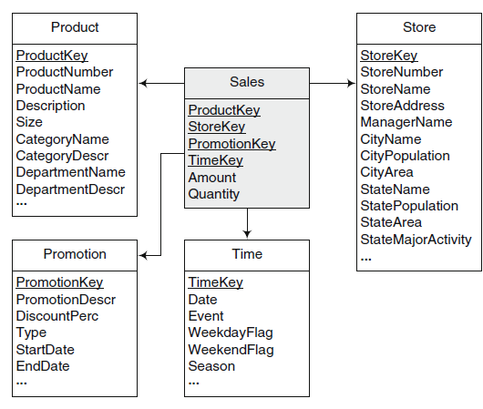
Example Star Schema

Slide 4
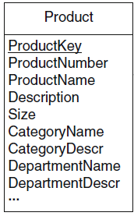
Start Schema
Example: Product Dimension
  All products belonging to the same category
  So, all the category information will be redundant

Slide 5
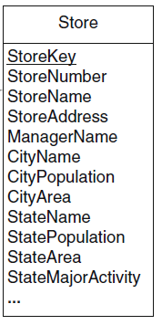
Start Schema
Example: Store Dimension
  All stores (unique) belong to the same city
    So, all the category information will be redundant
  All stores (unique) belongs to the same state
    So, all the state information will be redundant

Slide 6
Star Schema Keys
Primary keys (in dimension)
  Identifying attribute in dimension table
  Relationship attributes combine together to form P.K
Surrogate keys (in dimension)
  Replacement of primary key
  System generated
Foreign keys (in fact, dimension)
  Collection of primary keys of dimension tables
Primary key to fact table
  Collection of P.Ks

Slide 7
Types of Dimensions
Based on size (columns and data)
  Large dimensions
  Small dimensions
Based on changes to data
  Slowly Changing Dimensions
  Rapidly Changing Dimensions

Slide 8
Dimensions Types: Size
Based on size
  Large dimensions
  Small dimensions

Slide 9
Large Dimensions
A dimension is considered large based on two factors
  A large dimension is deep i.e. large no of rows
  A large dimension is wide i.e. large no of columns
For example, customer, product and time dimension may be gigantic
Multiple hierarchies
  Large dimensions tend to have multiple hierarchies

Slide 10
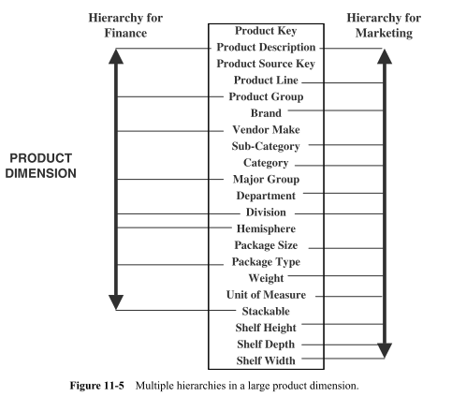
Example Large Dimension

Slide 11
Small Dimensions
Little deep
  Fewer rows
Little wide
  Fewer columns
Typically, single hierarchy
Examples
  Small Customer dimension
  Small Product dimension
  Small time dimension

Slide 12
Types of Dim: Data Changes
Based on changes to data of dimension
  Slowly Changing Dimensions
  Rapidly Changing Dimensions
Beforehand, lets discuss what are data changes

Slide 13
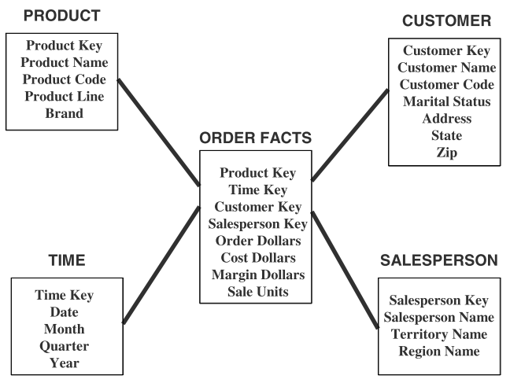
Updates to dimensions
Fact: sales units
Dimension: Product
  Change: A new product is added
Dimension: Customer
  New customer is added
  Customer is relocated
  Marital status is changed

Slide 14
Types of Changes
Type 1 Changes: Correction of errors
Type 2 Changes: History preservation
Type 3 Changes: Tentative revisions

Slide 15
Incremental load
DW is updated once
Next time update / incremental update

Slide 16
Type 1: Correction of Error
For example, spelling of customer name is changed from Hammad Ikram to Hammad Akram
  No need to preserve old value of Hammad “Akram”

Slide 17
Types 1: Correction of Error
Kristian Daniel to Kristian Denial and the martial status is changed from single to married
  No need to preserve old value of name
  But change in martial status is slightly different
Affect on result
  Number of perfume products bought by married persons

Slide 18
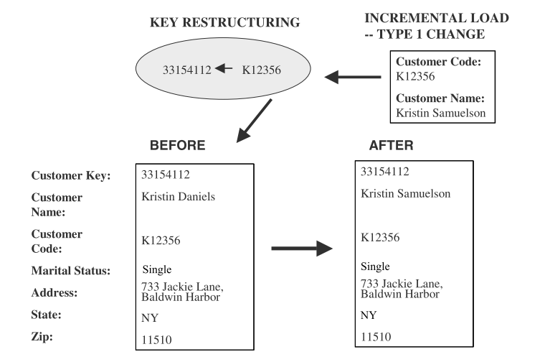
Types 1: Correction of Errors
Changes to DW
  Solution, over-write old values with new values
  Old value is not preserved
  Key is not affected
  Easiest to implement

Slide 19
Type 2 changes: Preservation of History
Assume that in DW an essential requirement is to track orders by marital status
  If change happed on 1 Jan 2024 all order before that should be included in martial status single.
  Similarly orders after that under marital status married
  Assume city is also change from LHR to ISL so both changes must be saved
Principles:
  Relate to true change in source systems
  There is a need to preserve history in DW

Slide 20
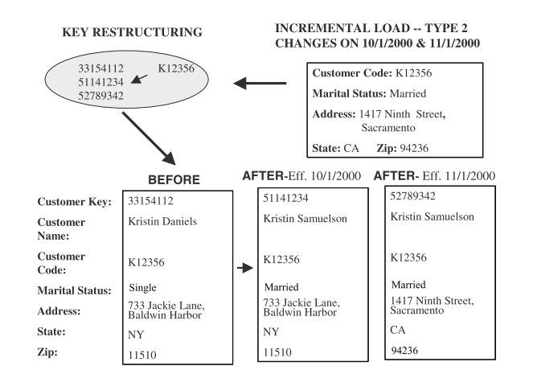
Type 2 changes: Preservation of History
Applying Type 2 changes in DW
  There are no change to the original row in dimension table
  Add a new dimension table row
  The key of the original row is not affected
  The new row is inserted with a new surrogate key

Slide 21
Type 3 changes: Tentative Soft Revisions
We apply Type 2 change to a certain date (the date is a cut off point)
  What if you need to count the orders on or after the cut-off date in both groups? This cannot be handled with type 2
  i.e. sometimes there is a need to track both old and new values for a certain period
  For instance, realigning territories

Slide 22
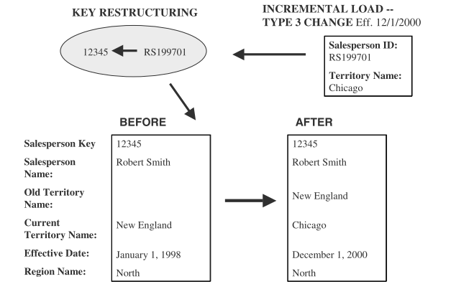
Type 3 changes: Tentative Soft Revisions
Solution
Add a new field in the dimension table
  Push down the existing values from current to old
  Keep the new values of the attribute in the “current” field

Slide 23
Summary of Types of changes
Change1. Correction of errors
  Problem, Name of a person is changed, to correct error
  Solution, over-write old value
  Old value is not saved
  Key is not affected, Easiest to implement
Change 2. History preservation
  Problem, Name is changed, marital status & address
  Solution, Inserting new row for each change
  Change has certain affect on analysis
  Key is not affected, new surrogate key
Change 3. Tentative revisions
  Problem, Old address of customer is not known
  Solution, Insert another attribute, with date
  New row is not needed

Slide 24
Recall Types of Dim: Data Changes
Based on changes to data of dimension
  Slowly Changing Dimensions
  Rapidly Changing Dimensions

Slide 25
Slowly Changing Dimension
Consideration of the changes to dimension table
  Many dimension, thought not constant over time, change slowly
  Product key of source record does not change
  Description and other attributes change slowly over time
  In OLTP new values overwrite old ones
  Overwriting not always appropriate option in DW

Slide 26
Rapidly Changing Dimension
For Type 2 changes, a new row is created with new attribute value
  Preserve the history
What if the change occurs too many times?
This dimension is no longer a slowly changing dimension
Particularly, in Large dim. frequent changes cannot be handled with any type of change

Slide 27
Rapidly changing dimensions
But consider a large customer dimension, where millions of customers may exist
  But significant attributes in a customer dimension may change many times in a year (rapidly changing dimension)
In the case if dimension table is too large and changing too rapidly
Solution????

Slide 28
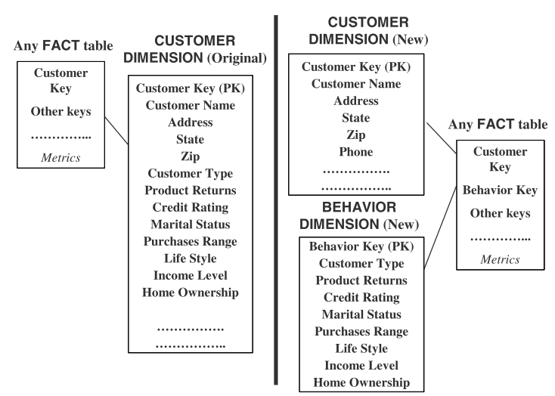
Rapidly changing dimensions
Leads to
Snowflake

Slide 29
Types of Dimensional Models
Star Schema (discussed)
Snowflake Schema
Starflake Schema
Constellation Schema

Slide 30
Snowflake Schema
Snowflake avoids the redundancy of star schemas by normalizing the dimension tables
Therefore, a dimension is represented by several tables related by referential integrity
Referential integrity constraints is also between fact table and the dimension tables at the fines level of details

Slide 31
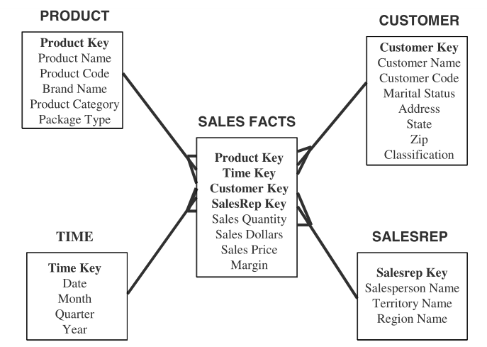
From Star to Snowflake Schema

Slide 32
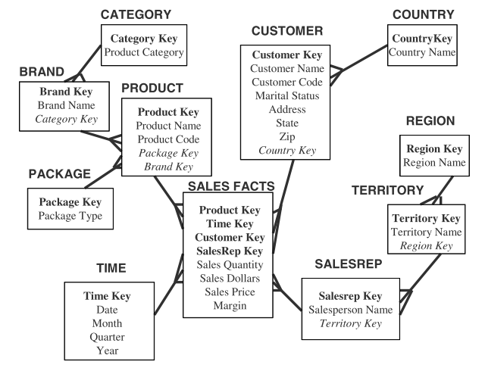
From Star to Snowflake Schema

Slide 33
From Star to Snowflake Schema

Slide 34
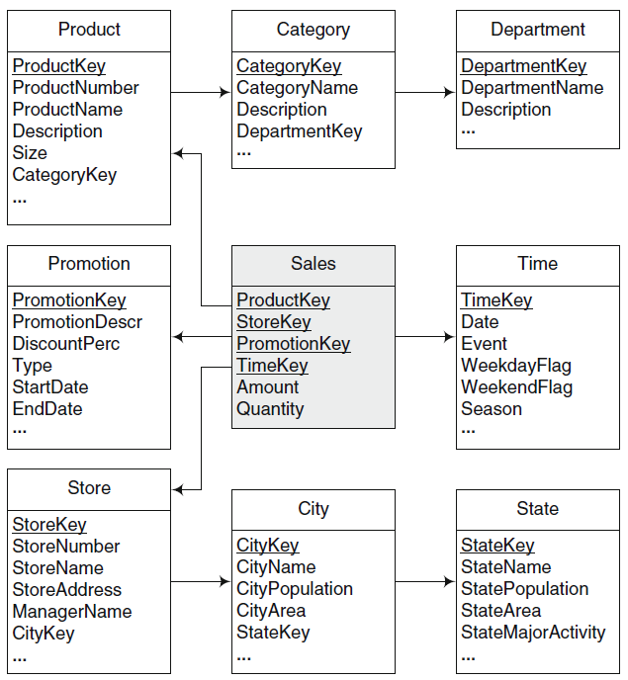
Example
Snowflake

Slide 35
Starflake Schema
A combination of star and snowflake.
Some dimensions are normalized while others are not
Constellation Schema
Schema has multiple fact tables that share dimension tables

Slide 36
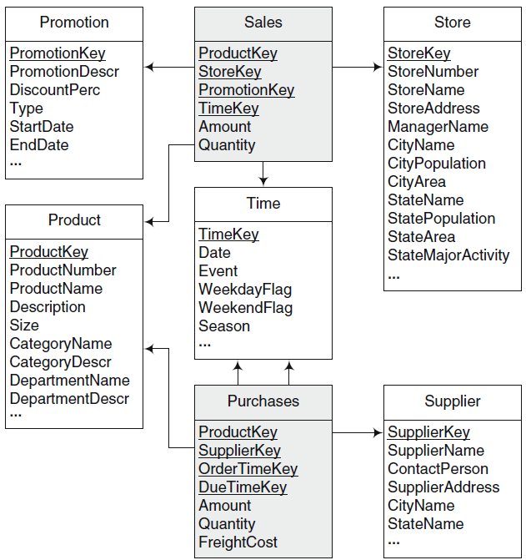
Constellation Schema Example

Slide 37
Summary of Schema Types
Snowflake schema
  Can be achieved by apply normal form on dimensions
  Advantages
    Decreased storage
    Normalized structures are easily updated
  Disadvantages
    Users are put-off to complexity
    Query performance is decreased due to join
Star-flake
  Some dimensions are normalized and some are not
Constellation schema
  Many star schemas

